Slide 1

European Signal Processing Conference 2011
View Interpolation With Structured Depth From Multiview Video
Pravin Kumar Rana and Markus Flierl
ACCESS Linnaeus Center
School of Electrical Engineering
KTH Royal Institute of Technology
Stockholm, Sweden
August 30, 2011

Slide 2
Outline
Motivation
Depth Consistency Testing
Inter-view Connection Information
Structured Depth Maps
Virtual View Interpolation
Experimental Results
Conclusions
Slide 1

Slide 3
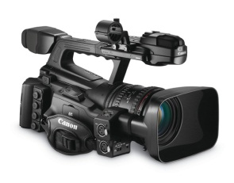
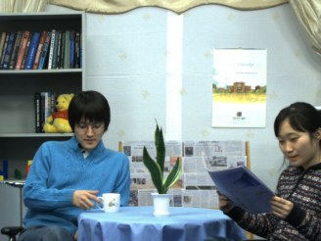
Imaging
Classical Imaging
Slide 2

Slide 4
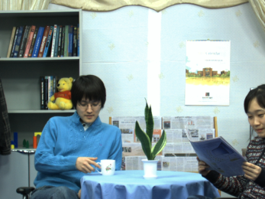
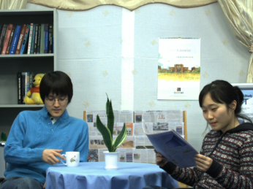
Imaging
Multiview Imaging
Slide 2

Slide 5

Application
User
Free Viewpoint TV
Slide 3

Slide 6
Application
User
Free Viewpoint TV
Slide 3

Slide 7
Application
User
Free Viewpoint TV
Slide 3

Slide 8
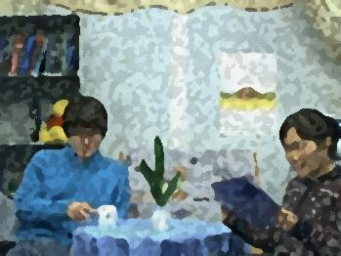
Application
User
Free Viewpoint TV
Slide 3

Slide 9
Application
Virtual View
User
Free Viewpoint TV
Slide 3

Slide 10
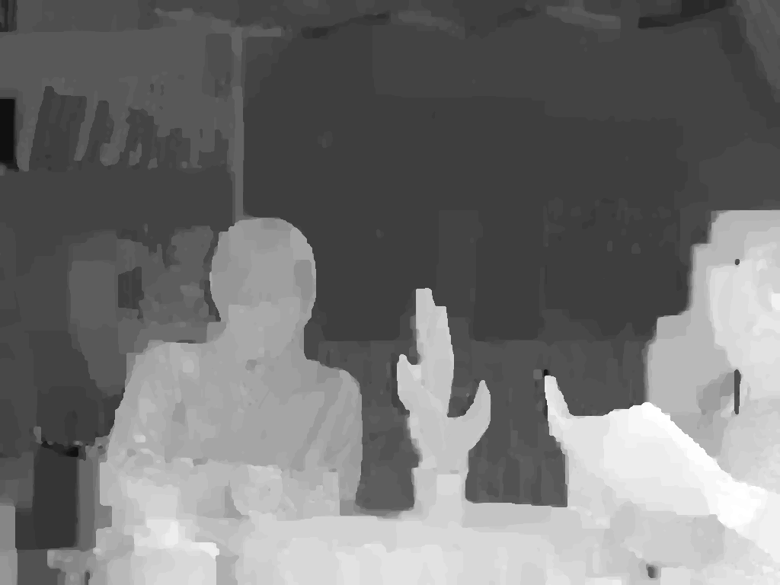
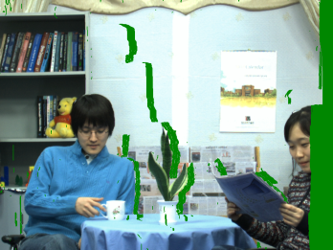

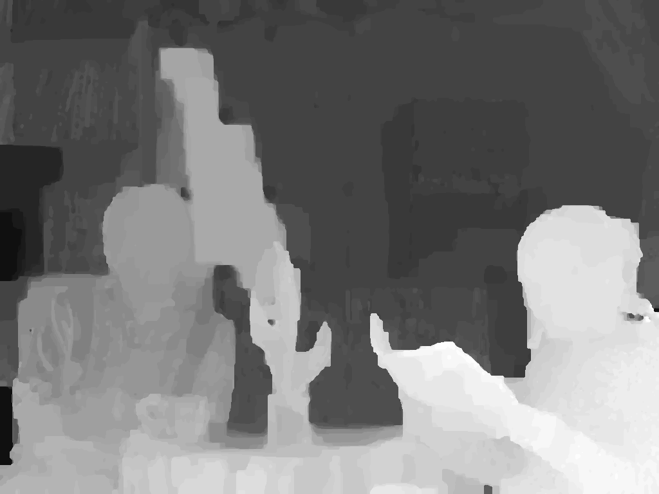
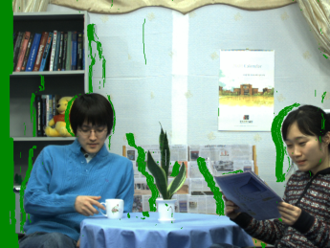
Virtual View Rendering
Estimated Depth
Warped Texture
3D Warping
Hole
Reference Texture
Hole Filling & Inpainting
Estimated Depth
Virtual Texture
3D Warping
Warped Texture
Reference Texture
MPEG View Synthesis Reference Software 3.5 (VSRS 3.5)
Slide 4

Slide 11



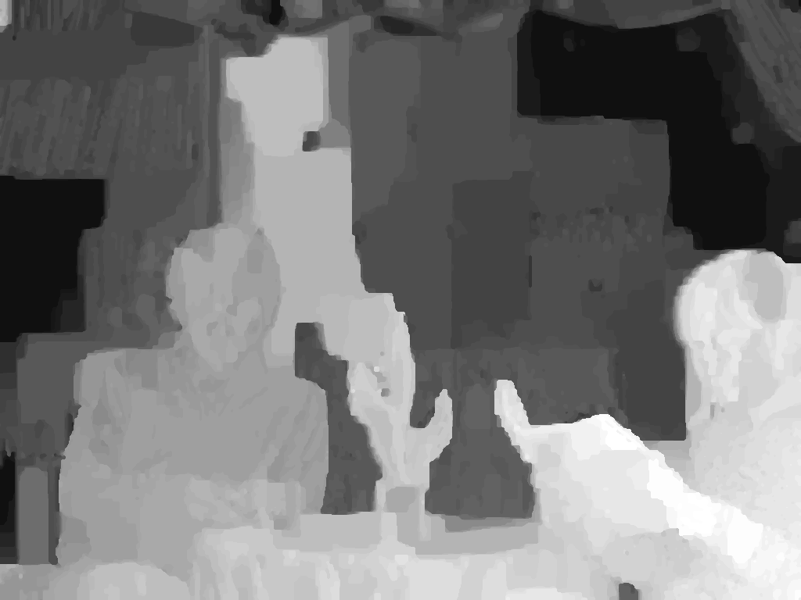
Depth Estimation
Reference Textures
Common Practice
Depth Estimation
(MPEG Depth Estimation Reference Software DERS)
Estimated Depth Map
Slide 5

Slide 12
Inter-view Depth Inconsistency
Newspaper
Slide 6

Slide 13
Inter-view Depth Inconsistency
Newspaper
Slide 6

Slide 14
Inter-view Depth Inconsistency
Newspaper
Slide 6

Slide 15
Inter-view Depth Inconsistency
Newspaper
Slide 6

Slide 16
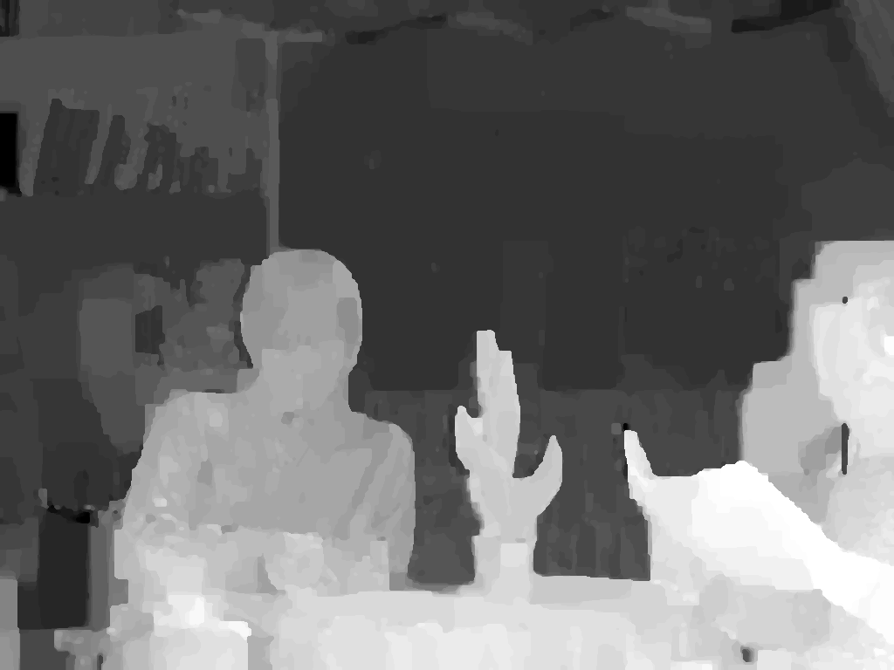

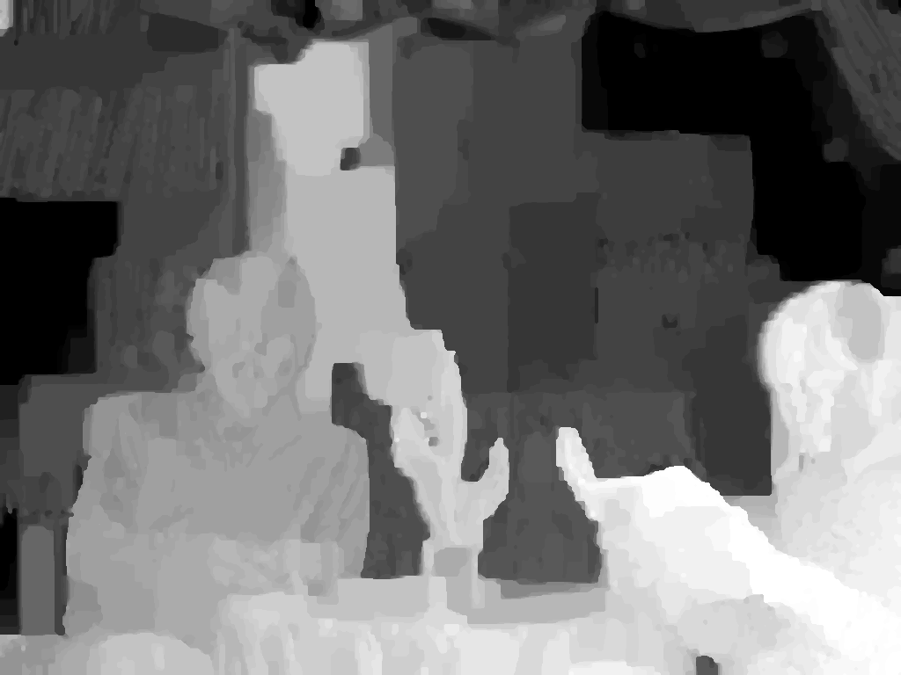
Multiple Depth Warping
Slide 7

Slide 17
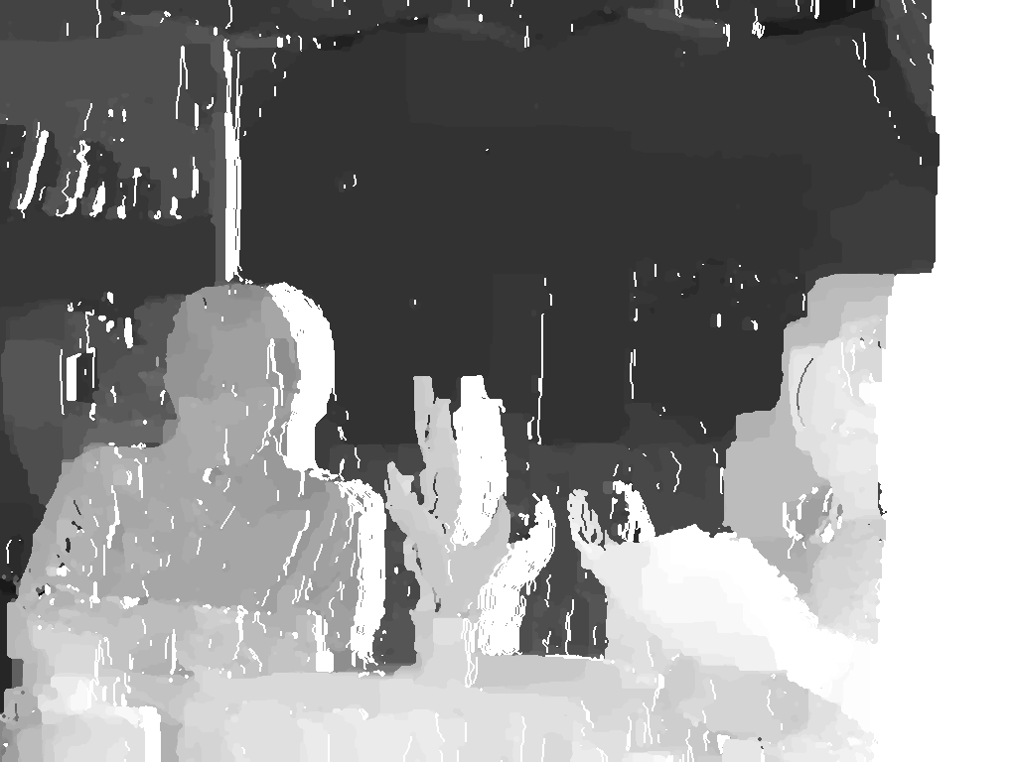
Multiple Depth Warping
3D Warping to
a principal viewpoint p
(1≤p≤n)
Hole
Slide 7

Slide 18
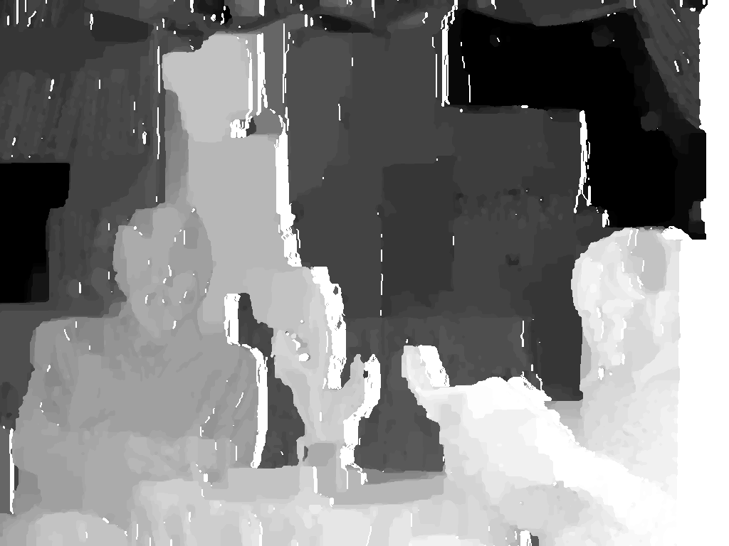
Multiple Depth Warping
3D Warping to
a principal viewpoint p
(1≤p≤n)
Hole
Slide 7

Slide 19
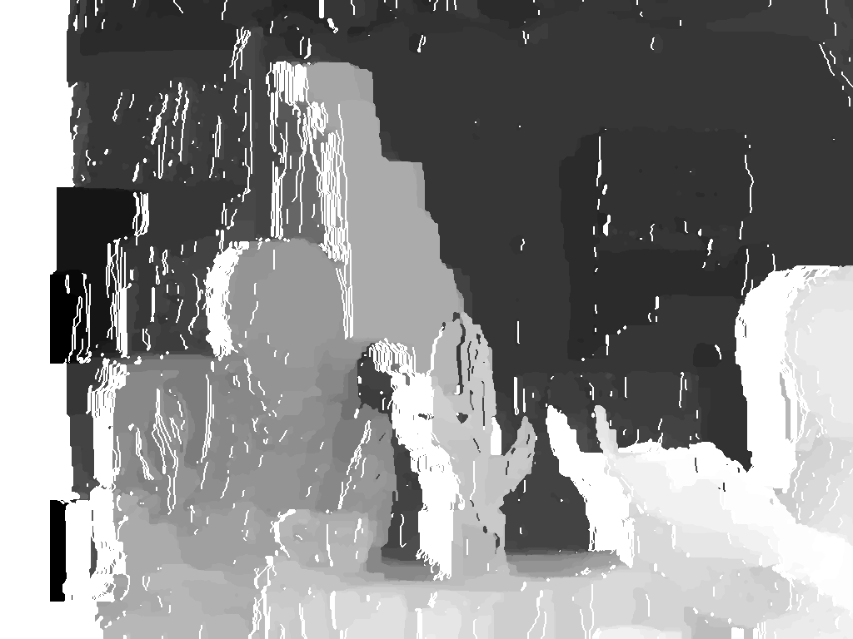
Multiple Depth Warping
3D Warping to
a principal viewpoint p
(1≤p≤n)
Hole
Multiple Warped Depth Maps at a principal viewpoint p
Slide 7

Slide 20
Connection Evidence
Absolute Difference
Matrix (ADM)
per pixel per frame
=
Pixel 1
where, ∆_{ij} = | d_{i} - d_{j} | is the absolute difference of depth values between warped depth map d_{i} and warped depth map d_{j} at a principal pixel
Slide 8

Slide 21
Connection Evidence
Absolute Difference
Matrix (ADM)
per pixel per frame
,
,
,
Up to depth
resolution
=
Pixel 1
Pixel 2
where, ∆_{ij} = | d_{i} - d_{j} | is the absolute difference of depth values between warped depth map d_{i} and warped depth map d_{j} at a principal pixel
Slide 8

Slide 22
Connection Evidence
Inter-view Connection Evidence
Absolute Difference
Matrix (ADM)
per pixel per frame
,
,
,
Up to depth
resolution
=
Pixel 1
Pixel 2
where, ∆_{ij} = | d_{i} - d_{j} | is the absolute difference of depth values between warped depth map d_{i} and warped depth map d_{j} at a principal pixel
Slide 8

Slide 23
Connection Evidence Testing
Connection Threshold
Define quality of the inter-view connection per frame
T=μ + λσ,
where,
μ = Mean of all ADM per frame
σ = Standard deviation of all ADM per frame
λ = Trade-off between quality of connection and number of connection, in the rendering experiment λ = 0.8.
Testing Rule
∆_{ij} < T : Accept the connection evidence and assume the corresponding depth pair have a consistent depth representation
∆_{ij} ≥ T : Reject the connection evidence
Slide 9
Notes:
2.2 Connection Hypothesis Testing
Connection evidence is a measure of inter-view
consistency.
Connection Threshold (Tf ):
•

Slide 24
Inter-View Connection Information
Example for inter-view connection information with three reference views, n=3.
Slide 10

Slide 25
Inter-View Connection Information
Example for inter-view connection information with three reference views, n=3.
Slide 10

Slide 26
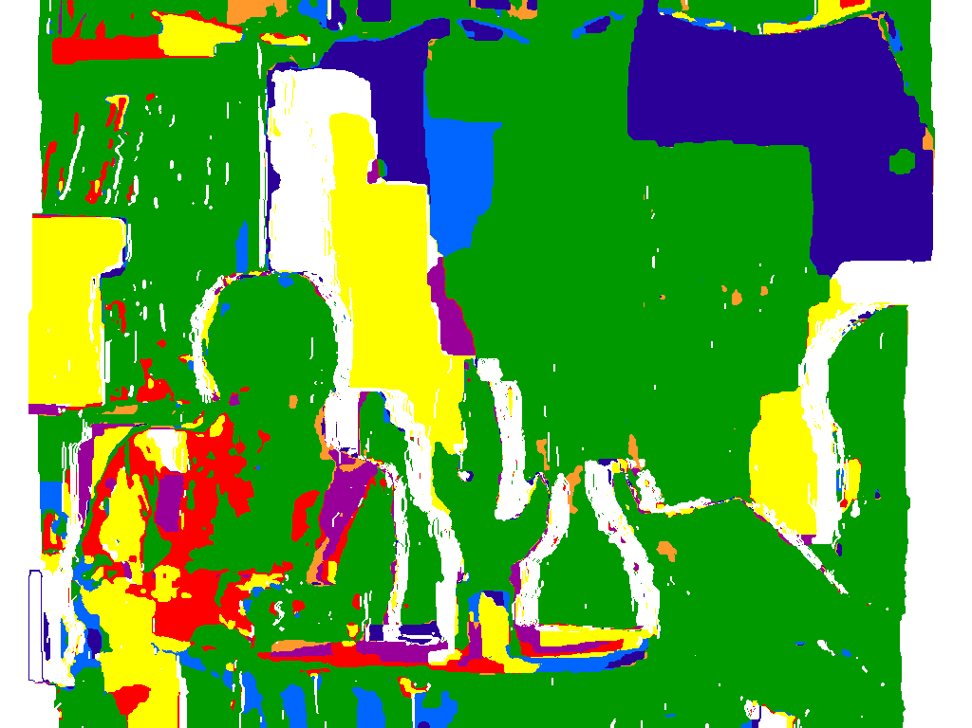
Inter-View Connection Information
Possible cases of inter-view connectivity for n = 3:
Use of Connection Information:
To obtain consistent depth values
To combine texture pixels from multiple viewpoint reliably
Slide 11

Slide 27
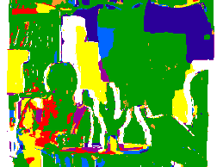
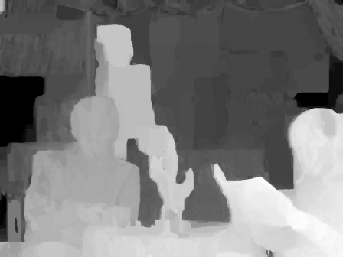
Principal Depth Map
Inter-view
Connection Information
Inter-view
connection Information
Depth Consistency Testing
Consistent Depth Values
Estimated Depth Maps
Principal Depth Map
Slide 12

Slide 28
Structured Depth Maps
To have inter-view consistent depth maps
To remove redundancy from depth maps
Slide 13
Notes:
The cardinality |d| of the set d depends
on the number of reference views used for depth consistency
testing to obtain the principal depth map dp. Let dr , r ∈ {1, . . . ,n},
represent an arbitrary reference depth map from viewpoint r which
is used in the depth consistency testing to obtain a principal depth
map at viewpoint p. The cardinality of the set d is defined by
|d| =
(n−1) if p = r, ∀ r,
n if p = r, ∀ r, (4)
where n is the number of reference views used in the depth consistency
testing

Slide 29

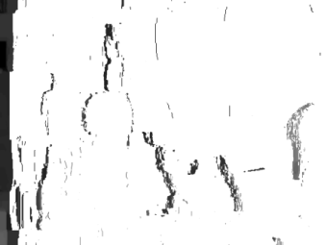
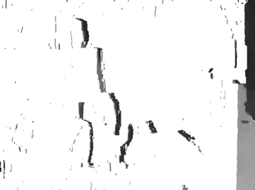
Structured Depth Maps
Structured
Depth Map
,
,
,
,
=
Principal Depth Map
A set of auxiliary depth information at given
auxiliary points
Cardinality of the set of auxiliary depth information:
|d´| =
where, N= total number of reference views used in the depth consistency testing.
(N-1) if p=r, for all reference viewpoint r,
N if p ≠ r for all reference viewpoint r,
Slide 14
Notes:
The cardinality |d| of the set d depends
on the number of reference views used for depth consistency
testing to obtain the principal depth map dp. Let dr , r ∈ {1, . . . ,n},
represent an arbitrary reference depth map from viewpoint r which
is used in the depth consistency testing to obtain a principal depth
map at viewpoint p. The cardinality of the set d is defined by
|d| =
(n−1) if p = r, ∀ r,
n if p = r, ∀ r, (4)
where n is the number of reference views used in the depth consistency
testing

Slide 30
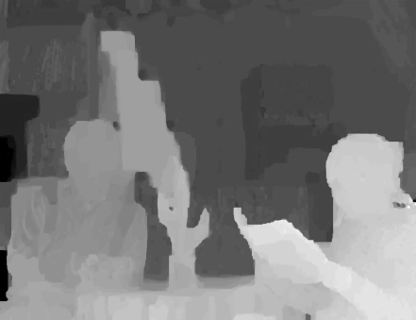



Extraction of Auxiliary Depth
Extraction
Reference Depth Map
Auxiliary Depth
Warping
Principal Depth Map
Occlusion Mask
Slide 15

Slide 31
Rendering Using Structured Depth Images
Multiview Video
Multiview Video
Inter-View Connection Information
Storage/
Transmission
Medium
Structured-Depth-Image-Based
Rendering
Structured Depth Estimation
Inter-View Connection Information
3D Scene Representation
Display
Structured Depth Maps
Structured Depth Maps
Slide 16

Slide 32
Virtual View Rendering
User
Free Viewpoint TV
Slide 17

Slide 33
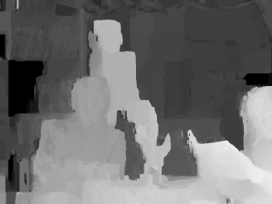
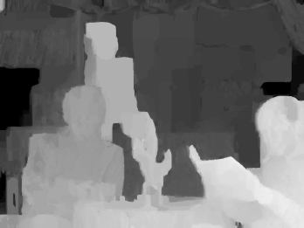
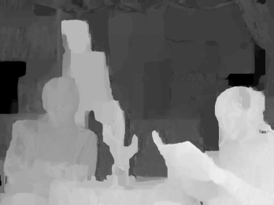
Virtual View Rendering
Enhanced depth maps
resulting from SDI
Slide 17

Slide 34
Virtual View Rendering
Multiview Texture
Slide 17

Slide 35
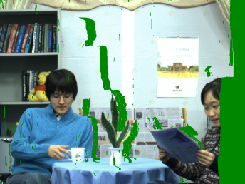
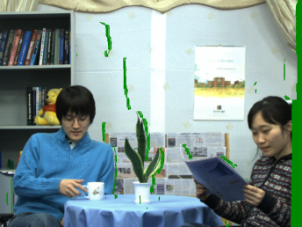
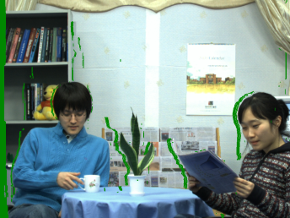
Virtual View Rendering
Warped views
at virtual viewpoint n
Warping
Warping
Warping
Slide 17

Slide 36
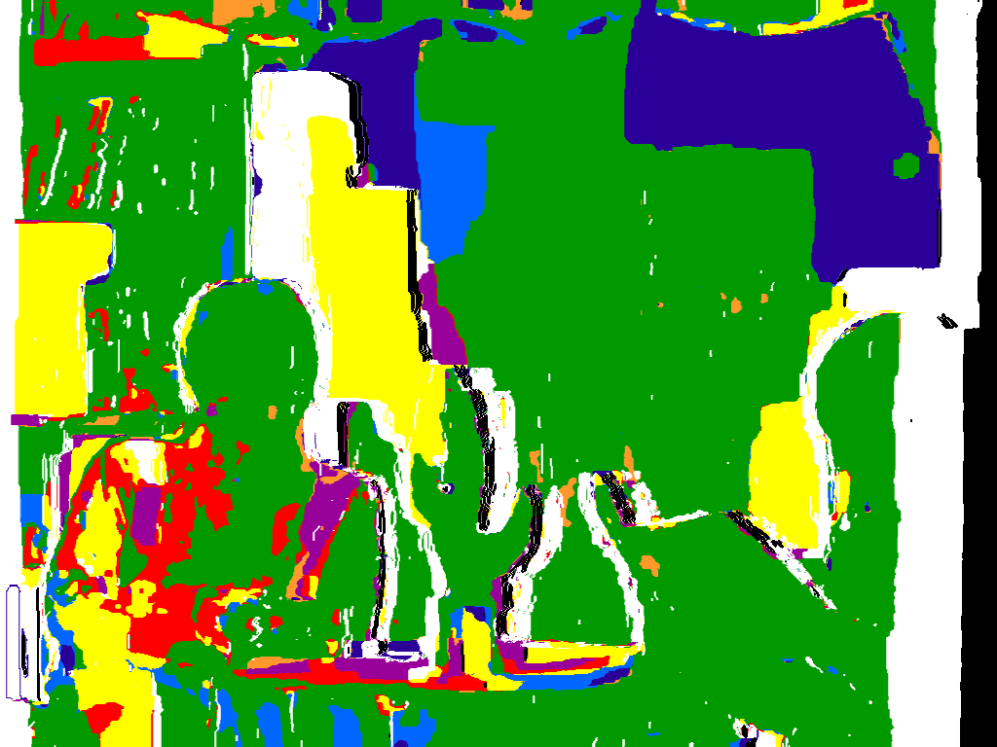
Virtual View Rendering
Warped views
at virtual viewpoint n
Warping
Warping
Masked Inter-view
Connection Information
Warping
Slide 17

Slide 37
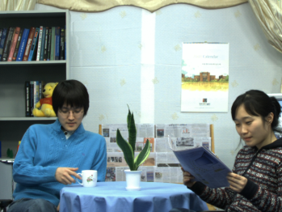
Virtual View Rendering
Warped views
at virtual viewpoint n
Warping
Warping
Connection-Adaptive
Pixel Intensity Estimation
Masked Inter-view
Connection Information
Warping
Slide 17

Slide 38
Experimental Results
[Left Bar ] : Proposed Method
[Right Bar] : VSRS 3.5
Mobile
Dog
Lovebird1
Newspaper
38 40 38 40 05 07 02 04 04 06
Slide 18

Slide 39
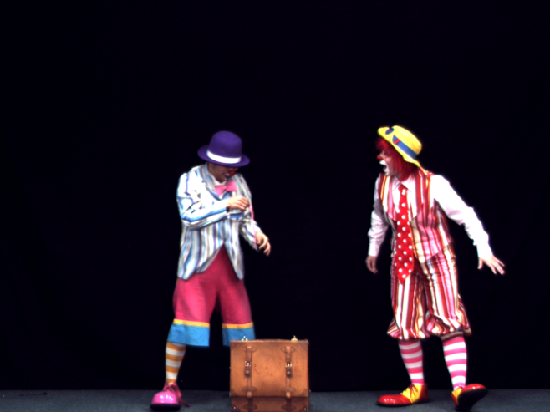
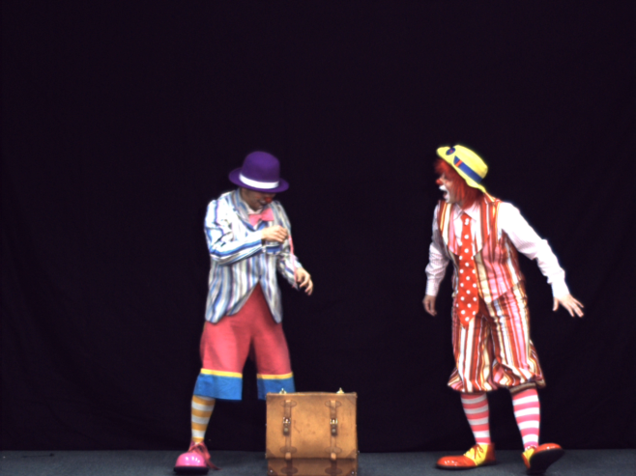

Experimental Results
Original
Virtual View by VSRS 3.5
Virtual View by Proposed Method
Error Image
Error Image
VSRS 3.5
Pantomime
Proposed Method
Slide 19

Slide 40
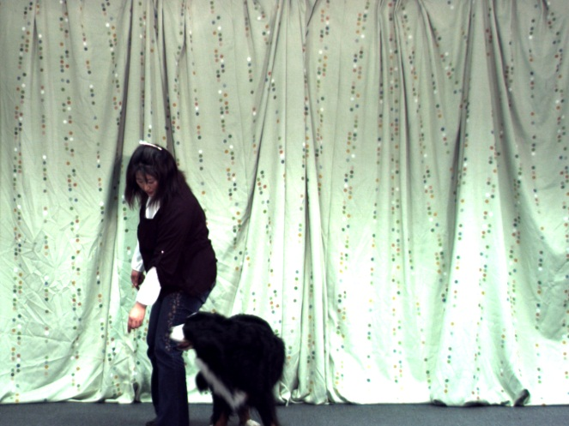
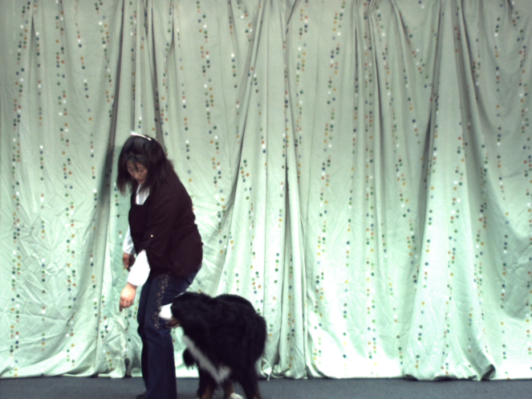




Experimental Results
Original
Virtual View by VSRS 3.5
Virtual View by Proposed Method
Original
Virtual View by VSRS 3.5
Virtual View by Proposed Method
Slide 20

Slide 41
Conclusions
Depth consistency testing and resulting the inter-view connection information allow to exploit consistency among depth maps
Structured depth addresses the problems of inter-view depth inconsistencies
Structured depth permit an appealing 3D scene representation
Structured depth maps and connection information improves the quality of rendered views
Slide 21

Slide 42
Thank You

